Slide 1
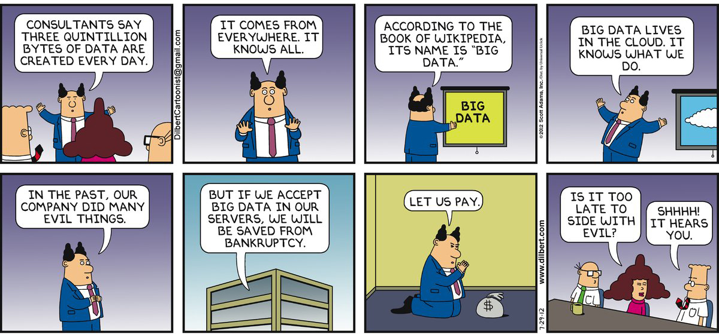
Serverless Computing
12th April, 2019
Arjun Singhvi
Notes:
Good Morning. I’m a PhD student working with Prof. Akella and am broadly interested in Systems and Networking. Today, we will be talking about Serverless Computing.

Slide 2
Overview
Motivation
Introduction
Use Case 1 – Distributed Computing
Use Case 2 – Video Encoding
Serverless Storage System
Open Challenges
Notes:
Today’s lecture is divided into 5 parts.

Slide 3
Occupy the Cloud: Distributed Computing for the 99%
Encoding, Fast and Slow: Low-Latency Video Processing Using Thousands of Tiny Threads
Elastic Ephemeral Storage for Serverless Analytics
Serverless Computation with OpenLambda
Pipsqueak: Lean lambdas with Large Libraries

Slide 4
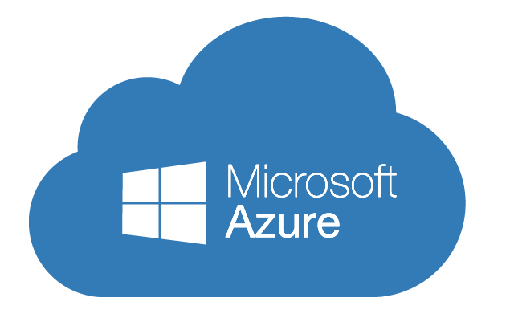


Motivation
Advent of cloud computing has simplified access to computing resources
Notes:
As you all now, the advent of cloud computing has simplified access to computing resources. As users, we no longer need have on-prem clusters and can rely on cloud providers to provide us with the necessary infrastructure and rely on them for cluster management.

Slide 5
Motivation: Cloud Providers Curse
However, users still need to do non-trivial planning and workload management
For example, AWS offers 70 instance types across 14 datacenters with different pricing
Companies exist which help users manage services of cloud providers!
Notes:
However, users still are involved in the planning and workload management. For example, AWS offers 70 instance types across 14 datacenters with different pricing. As a matter of fact, there are a number of companies that help users manage services of cloud providers!

Slide 6
Motivation: Server Abstraction Issues
Servers are difficult to configure and manage
High startup time severely limits quick scale up and down
Notes:
More concretely, servers are difficult to configure and manage. Also, say you want to provision your application to be reactive to the incoming load and scale accordlingly. one needs quick scale up an down – however, not all server abstractions are fit for this.

Slide 7
Motivation: Goals
To ensure minimal user involvement in the configuration and management of servers
Enable users to focus on the core application logic
Essentially, zero user administration
Notes:
Fairly straightforward

Slide 8



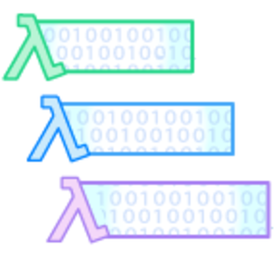
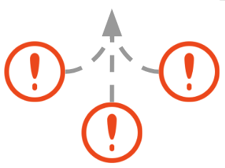
Introduction
Upload your function to the serverless computing platform and register for event-based triggers
Platform runs your function ONLY
when triggered
Pay just for the time computation was done
Execution is triggered when an event occurs
Notes:
You start with uploading your function to the platform and register for triggers. The triggers can be say an incoming HTTP request, an entry in the DB and so on. The execution is triggered only when an event occurs and the you just pay for the time computation was done.

Slide 9






Introduction
University of Wisconsin - Madison
Google
Amazon
Microsoft
IBM
Notes:
Over the last year or so, there has been tremendous interest regarding the same – all the major companies have their own offering of serverless computing, startups have come up and in fact Madison has it’s own serverless platform from Prof. Remzi’s group.

Slide 10
Introduction: Development Approach
Forces developers to think of their application as a set of functions
Deployment unit is a function and not an entire application
Notes:
One of the key differences in the serverless computing paradigm is that the developers are forced to think of their application as a set of functions as opposed an entire application. Deployment unit is a function and not an entire application.

Slide 11
Introduction
Computational units are
Short-lived
Stateless
Serverless platform has the ability to scale up and down automatically
To reduce the overhead of launching a new computation unit, the platform keeps it around in anticipation of a new request
Notes:
Now, getting into more details. The computational units are short-lived and stateless. These are not fundamental characteristics of serverless computing and would change over time.
The platform has the ability to scale up and down. To reduce overhead, computational units are kept around.

Slide 12
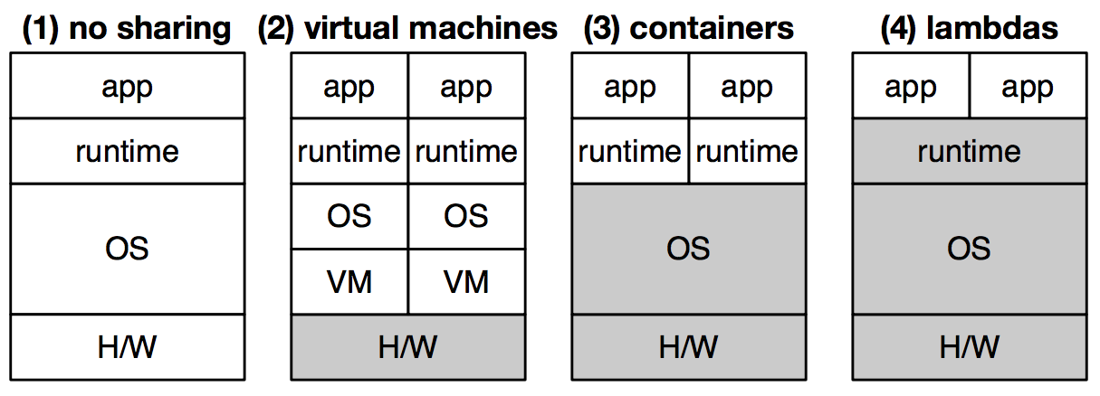
Introduction: Computational Units
Evolution of Sharing
Think of lambdas as containers + shared runtime
Notes:
Until now, I have been vague about what exactly the computational unit is. Think of lambdas as containers + shared runtime 🡪 More sharing means you can pre initialize and can save startup cost. Again, to be clear this computation unit could be something else – it could be a VM too – could be depending on the application.

Slide 13
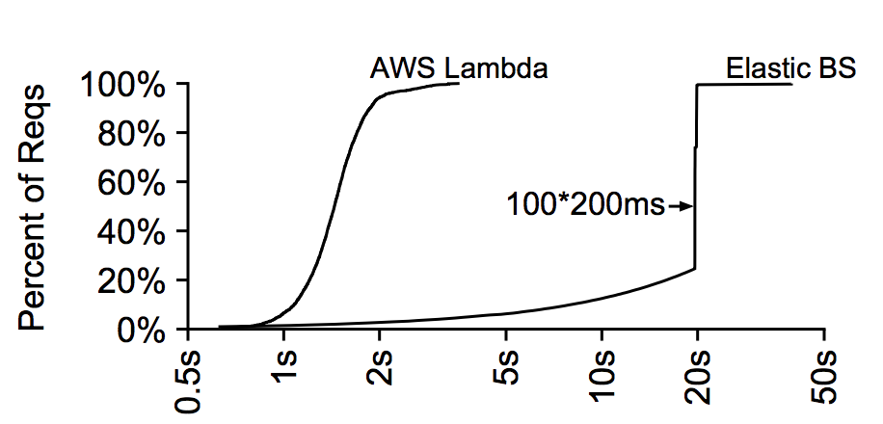
Introduction: Elasticity
Burst of 100 RPC requests
Each RPC lasts for 200ms
Notes:
This shows the serverless platforms can scale.

Slide 14
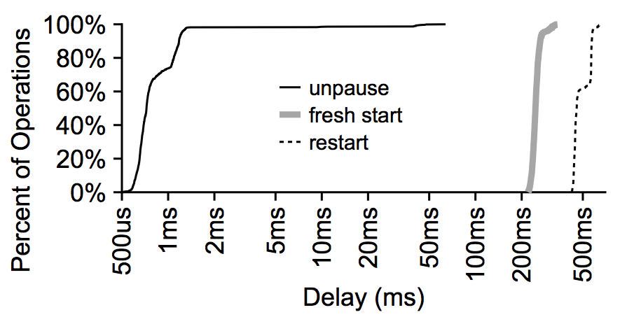
Introduction: Mitigate Launching Overhead
Keep containers around in anticipation of future requests
Kept around by pausing the containers
Notes:
Since the deployment units are functions, there is a greater need to reduce the startup overhead. Most of these platforms, keep containers around so that a new request does not incur the startup latency.
As the graph shows, the latency to unpause is less as compared to the other two.

Slide 15








Use Case 1 – PyWren - Motivation
There have been a number of distributed computational frameworks
Notes:
The motivation for PyWren is similar to the motivation for serverless computing. There have been a number of big data frameworks. You would have looked at most of them as a part of this course.

Slide 16
Use Case 1 – PyWren - Motivation
Yet, a majority of people do not use these frameworks
PySpark
Spark
HDFS
YARN
JVM
Notes:
However, a majority of the people do not use these frameworks due to their inherent configuration complexity.

Slide 17
Use Case 1 – PyWren - Goal
Distributed computing for the mass
Notes:
The key goal for pywren is to bring distributed computing to the masses.

Slide 18
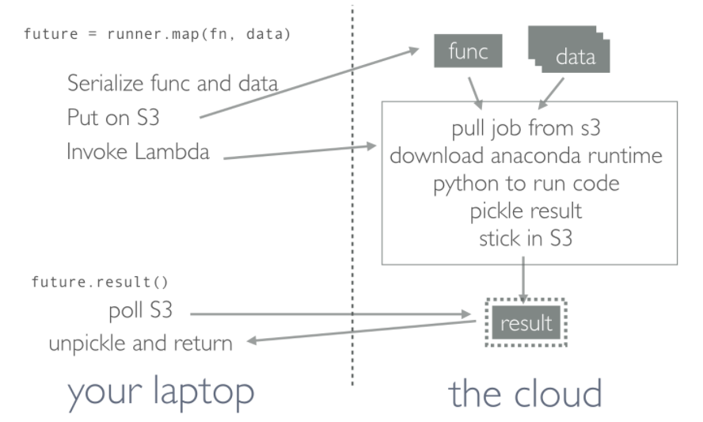
Use Case 1 – PyWren - Design
Data locality is not relevant anymore
Notes:
One of the key assumptions that PyWren makes is that data locality is no longer relevant. This is at odds with what big data systems have been doing.
PyWren also supports simple computational patterns in a way the platform was not designed to be used.
As seen in the diagram, the function and input data is serialized and put on S3, lambda is invoked, server side - …... and describe the control flow

Slide 19
Use Case 1 – PyWren - MapReduce
Little detail provided about how complex computational patterns can be achieved
To implement MapReduce
Driver (on laptop) launches the map phase
Driver (on laptop) polls S3 for completion of map phase
Driver (on laptop) then launches the reduce phase
Notes:
The paper provides little detail about how complex computational patterns can be implement.

Slide 20
Use Case 2 – ExCamera - Motivation
Goal - Google Docs for Video
People can interactively edit and transform a video
The changes are instantly visible for the others
Notes:
The paper provides little detail about how complex computational patterns can be implement. Driver launches the map phase, polls for completion, launches reduce phase

Slide 21
Use Case 2 – ExCamera - Motivation
Goal - Google Docs for Video
People can interactively edit and transform a video
The changes are instantly visible for the others
Problem
Currently, running such pipelines on videos takes hours and hours, even for a short video
Notes:
The paper provides little detail about how complex computational patterns can be implement. Driver launches the map phase, polls for completion, launches reduce phase

Slide 22
Use Case 2 – ExCamera - Motivation
Can we achieve interactive video editing by using massive parallelism?
Notes:
The paper provides little detail about how complex computational patterns can be implement. Driver launches the map phase, polls for completion, launches reduce phase

Slide 23
Use Case 2 – ExCamera - Motivation
Can we achieve interactive video editing by using massive parallelism?
But …
The finer-grained the parallelism, the worse the compression efficiency.
Notes:
The paper provides little detail about how complex computational patterns can be implement. Driver launches the map phase, polls for completion, launches reduce phase

Slide 24
Use Case 2 – ExCamera - Design
Built mu -
Library to run parallel computations on serverless platforms
Starts up thousands of threads in seconds and manages inter-thread communication
Parallelized the slow parts of video compression and serialized the fast part of video compression
Notes:
The paper provides little detail about how complex computational patterns can be implement. Driver launches the map phase, polls for completion, launches reduce phase

Slide 25
Use Case 2 – ExCamera - Background
Exploit the temporal redundancy in adjacent images
Store the first image on its entirety: a key frame
For other images, only store a "diff" with the previous images: an interframe.
Notes:
The paper provides little detail about how complex computational patterns can be implement. Driver launches the map phase, polls for completion, launches reduce phase

Slide 26
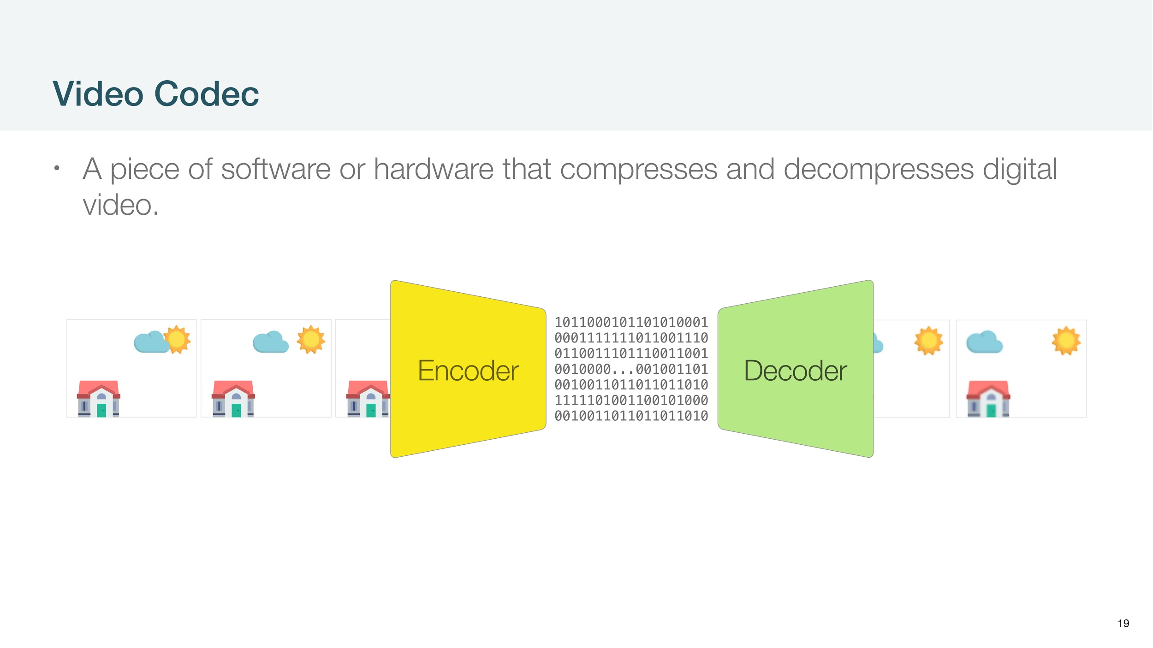

Slide 27
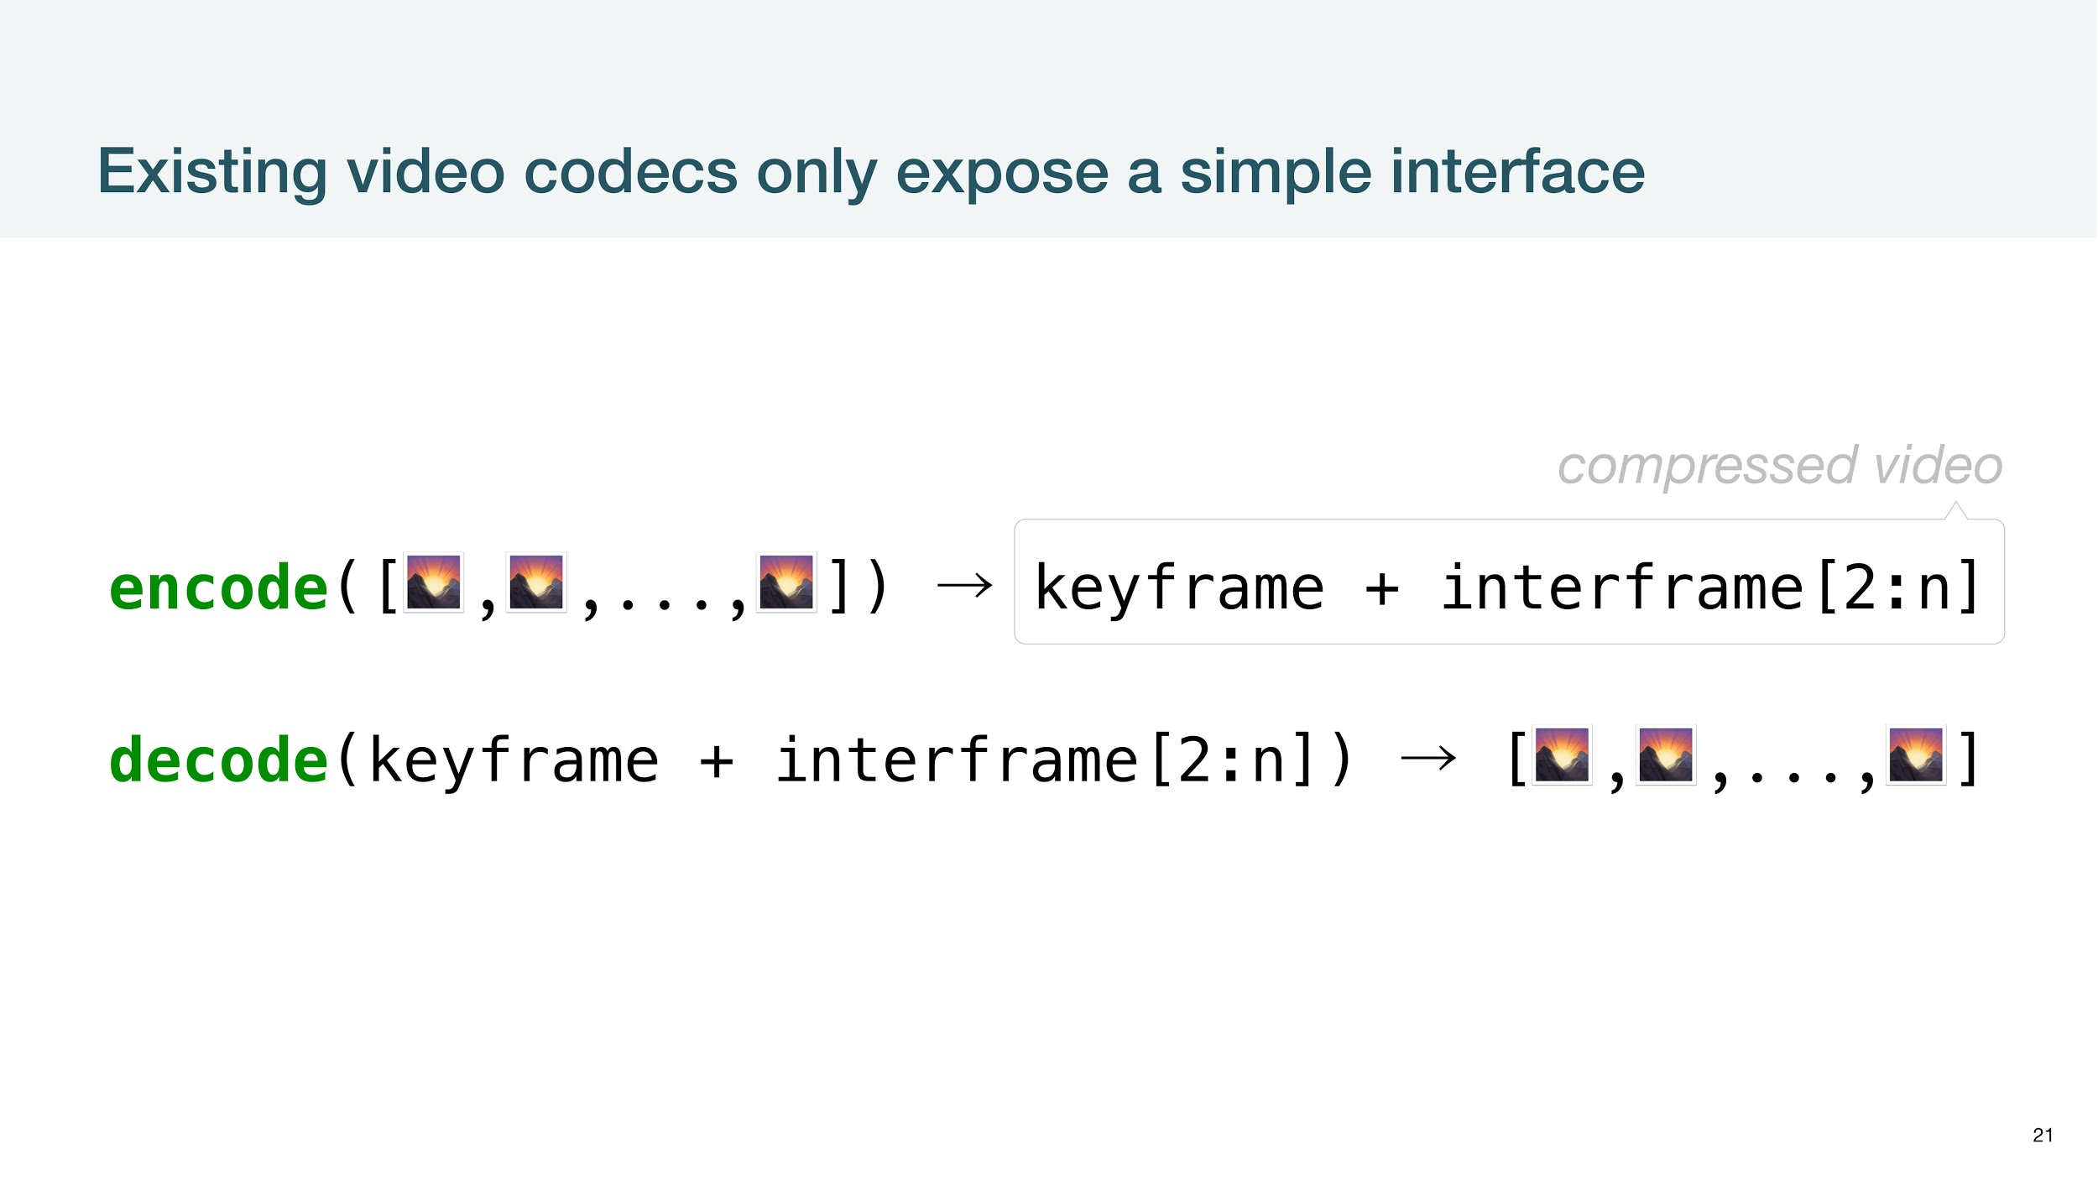

Slide 28
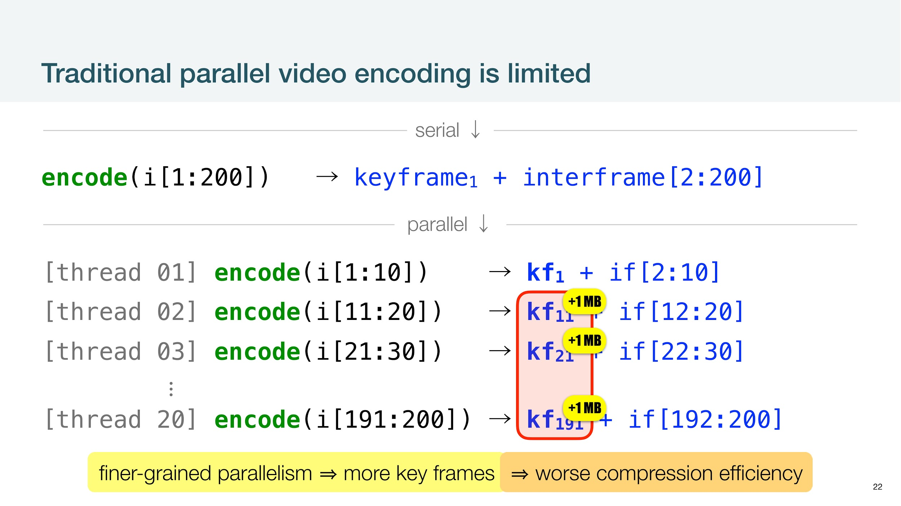

Slide 29
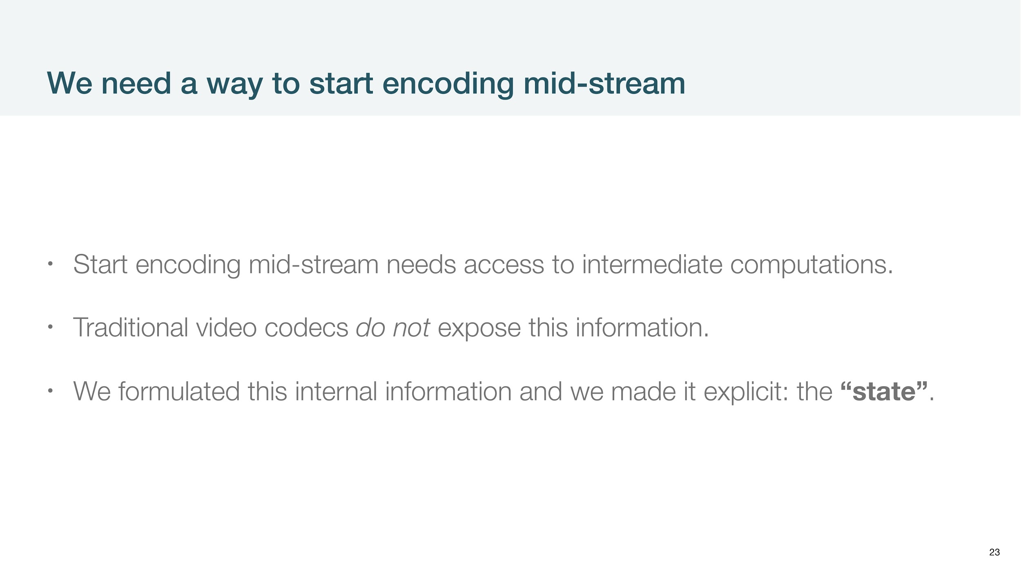

Slide 30
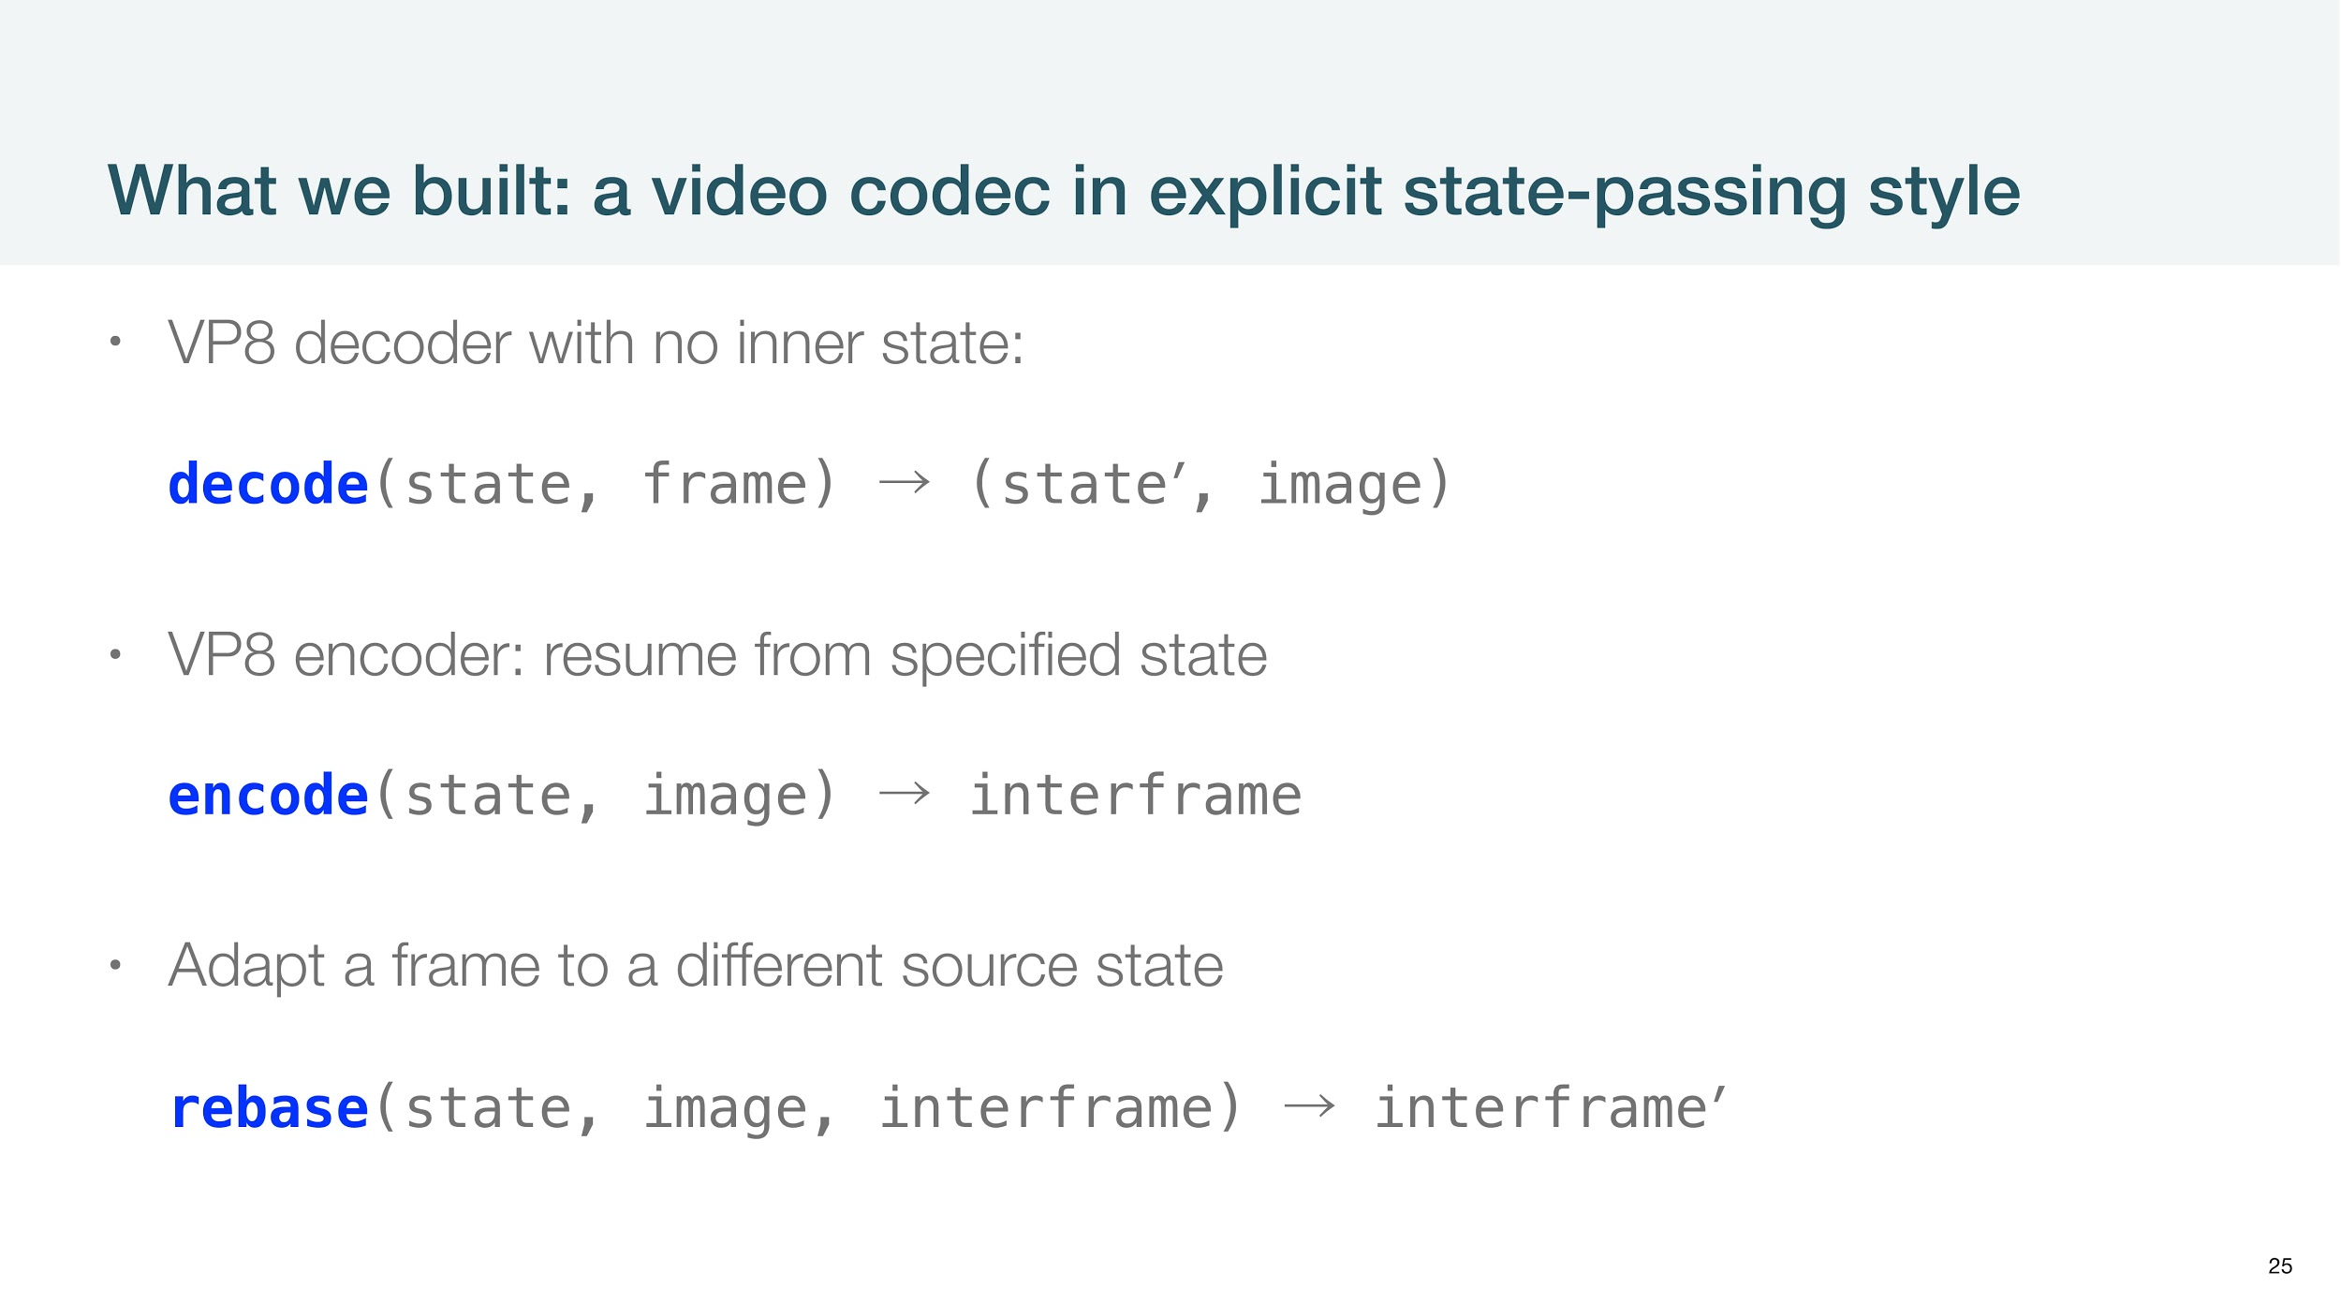

Slide 31
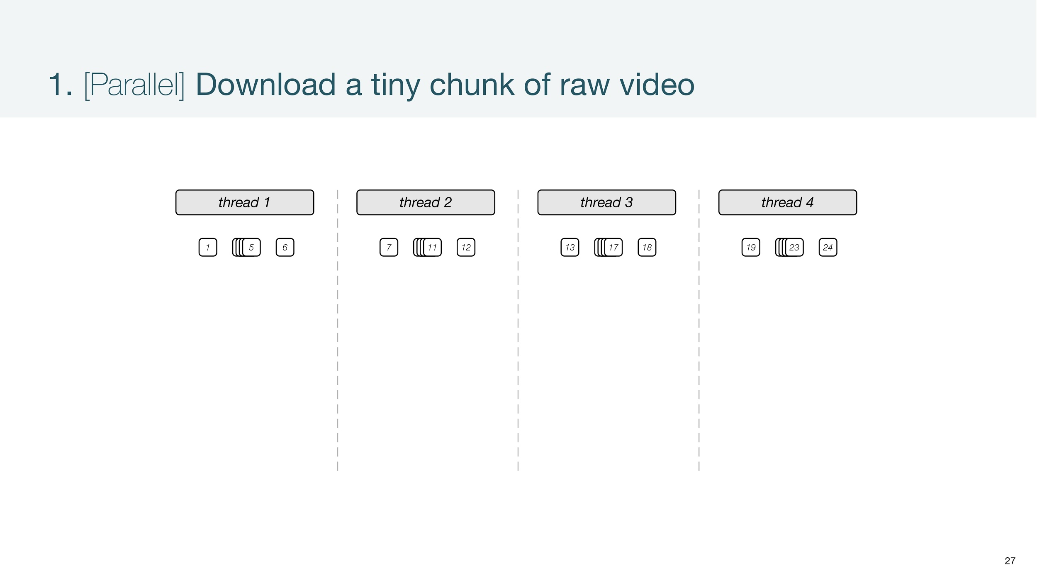

Slide 32
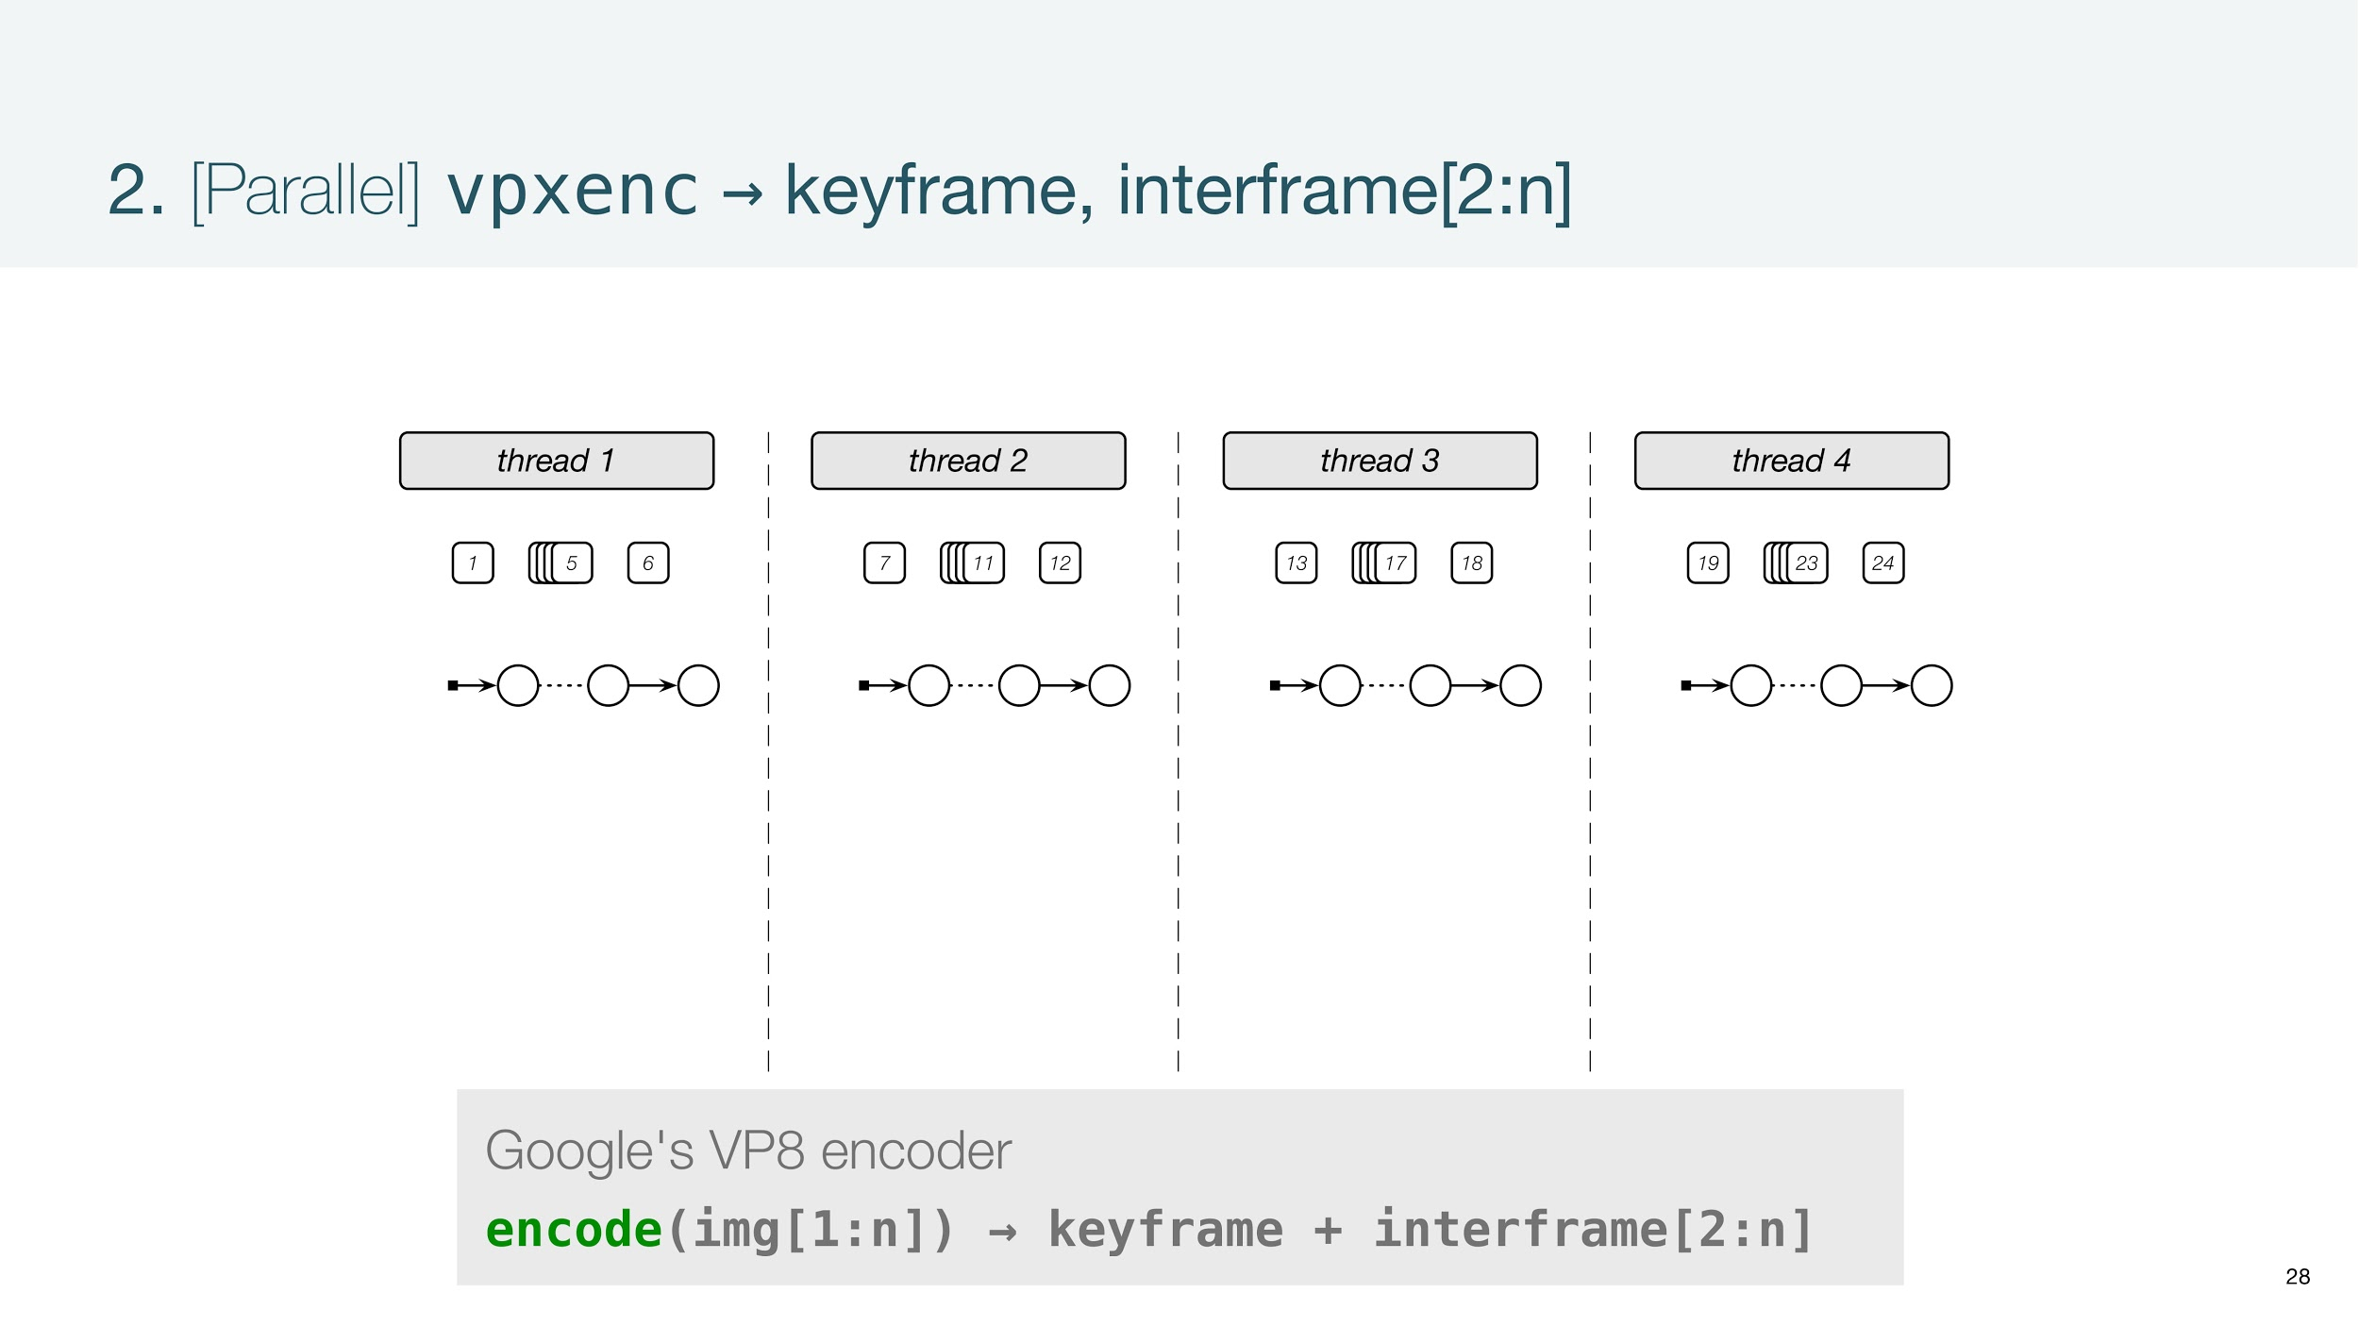

Slide 33
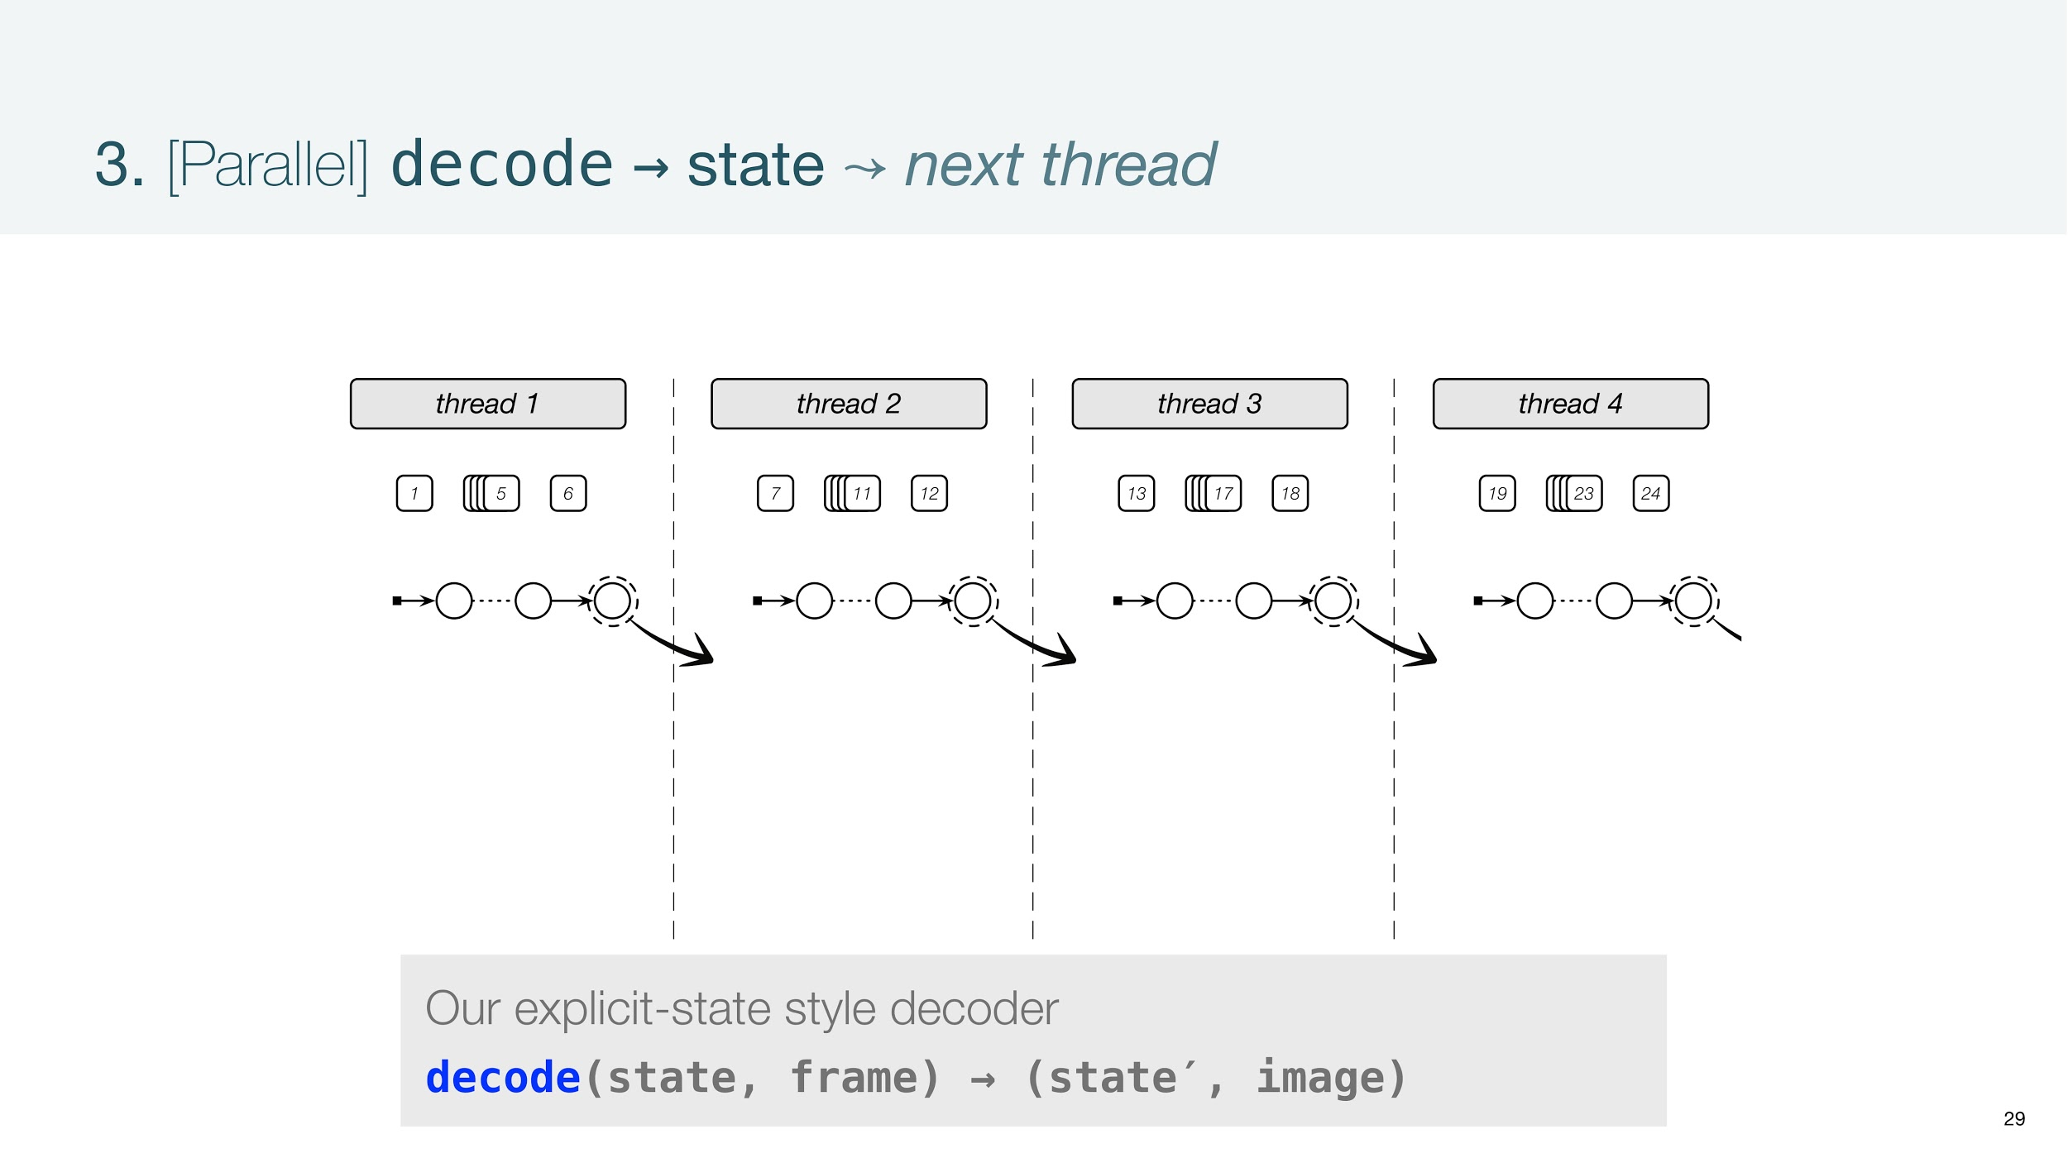

Slide 34
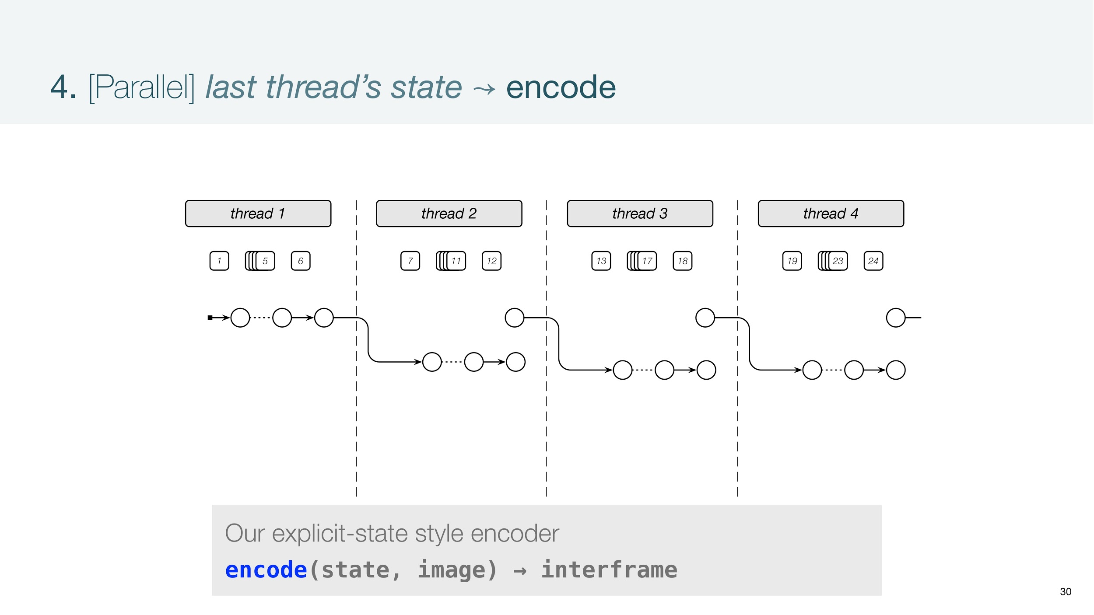

Slide 35
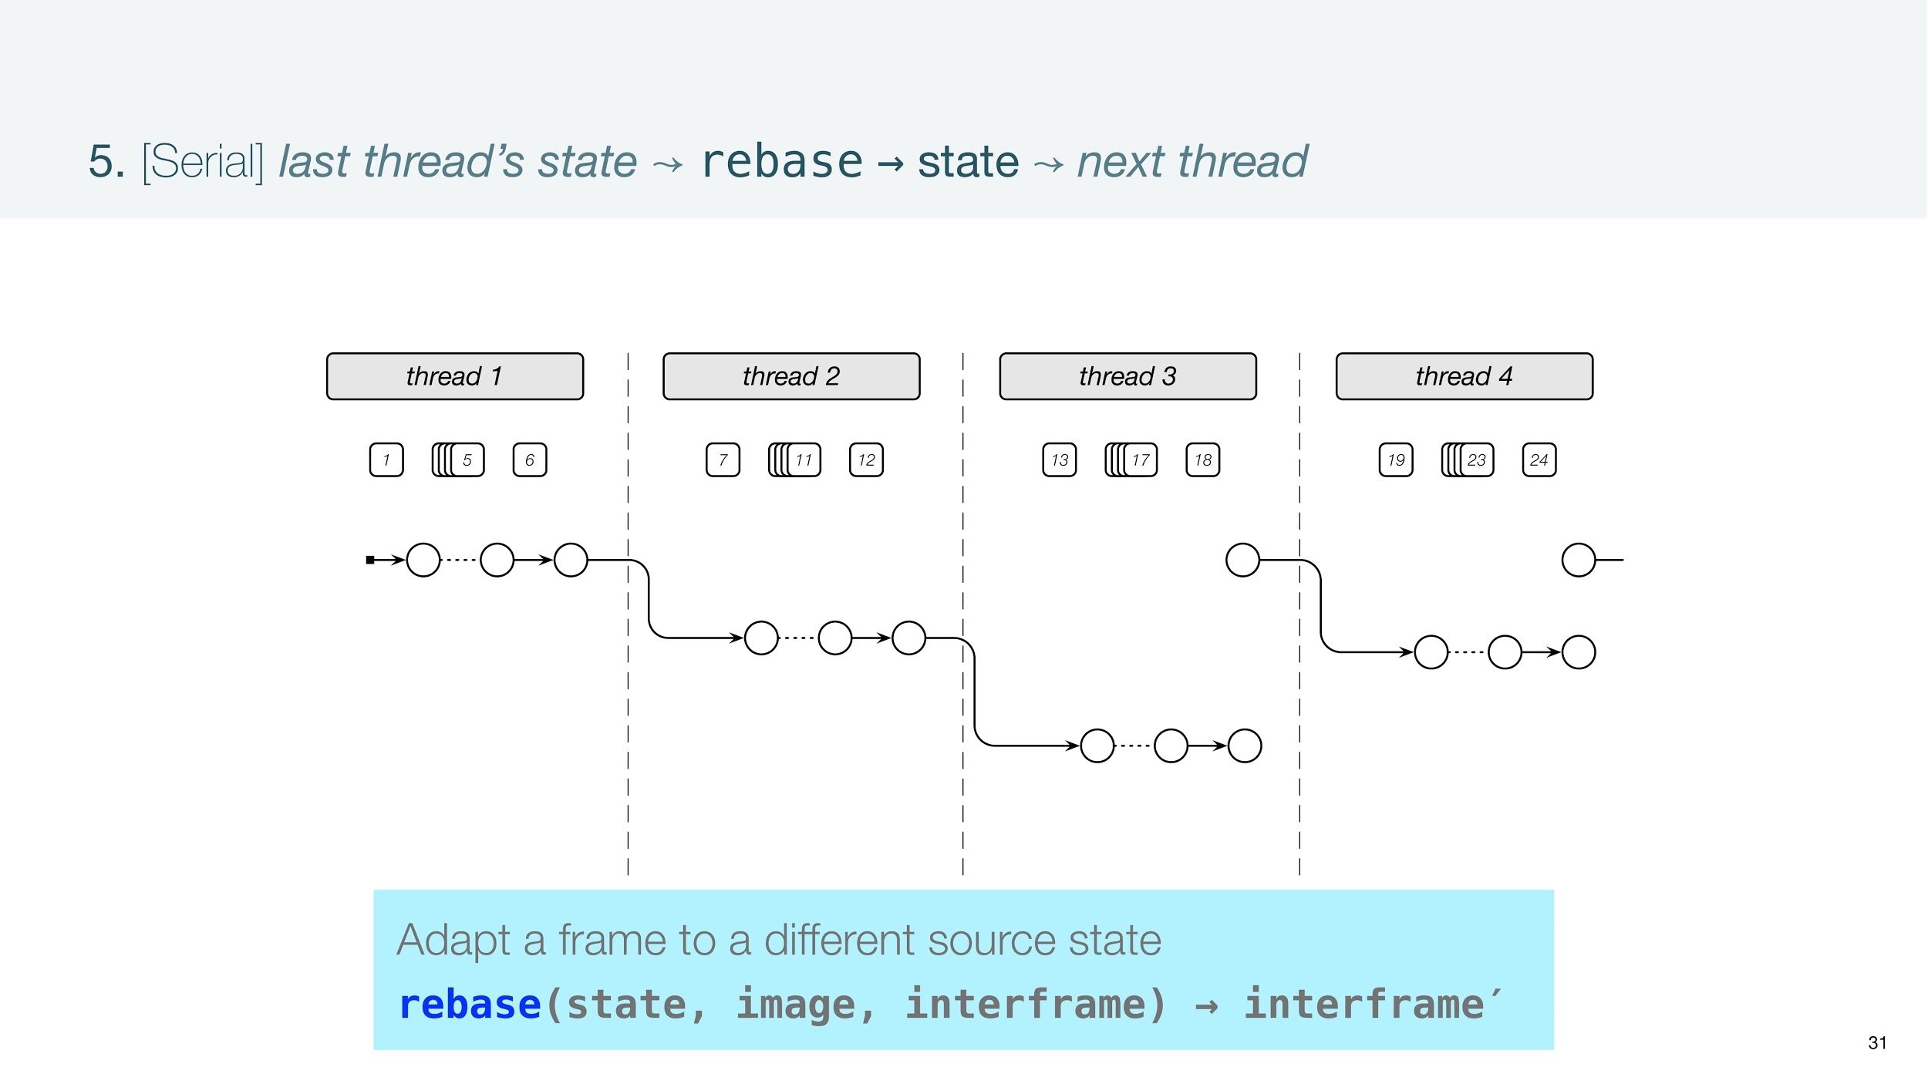

Slide 36
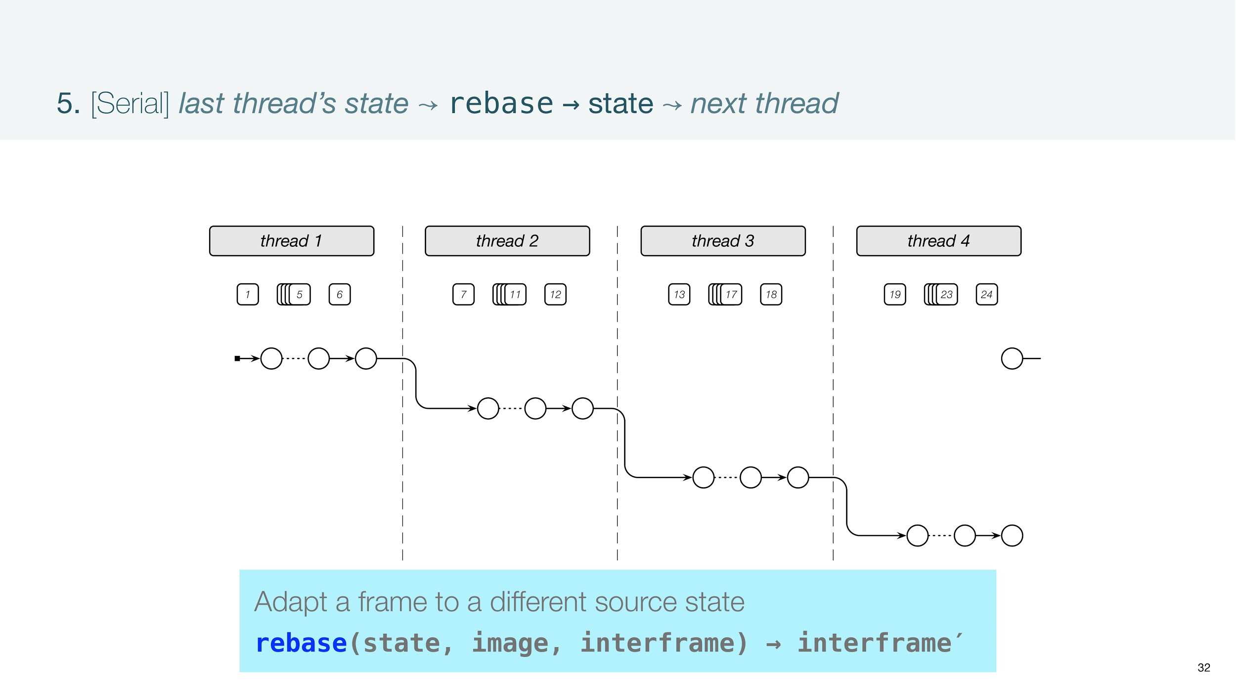

Slide 37
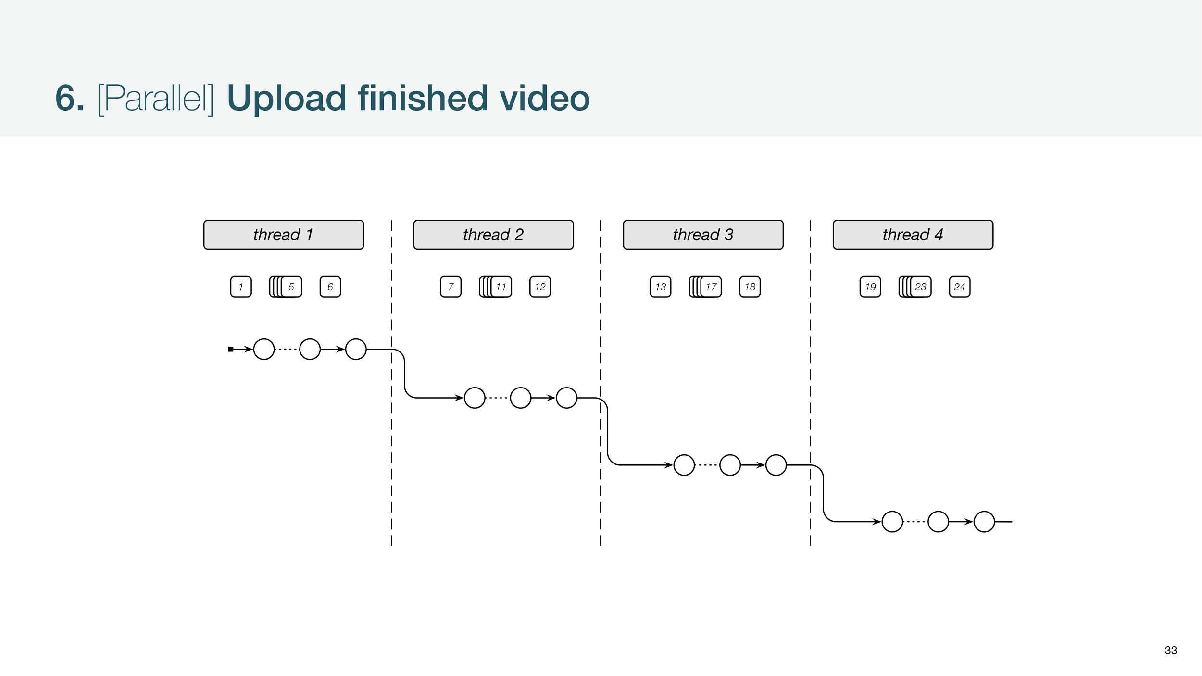

Slide 38
Ephemeral Storage Requirements
High performance for a wide range of objects
Cost efficiency, i.e, fine-grained, pay-what-you-use resource billing
Elastic Scaling
Fault-tolerance
Existing cloud storage options do not fit the requirements

Slide 39
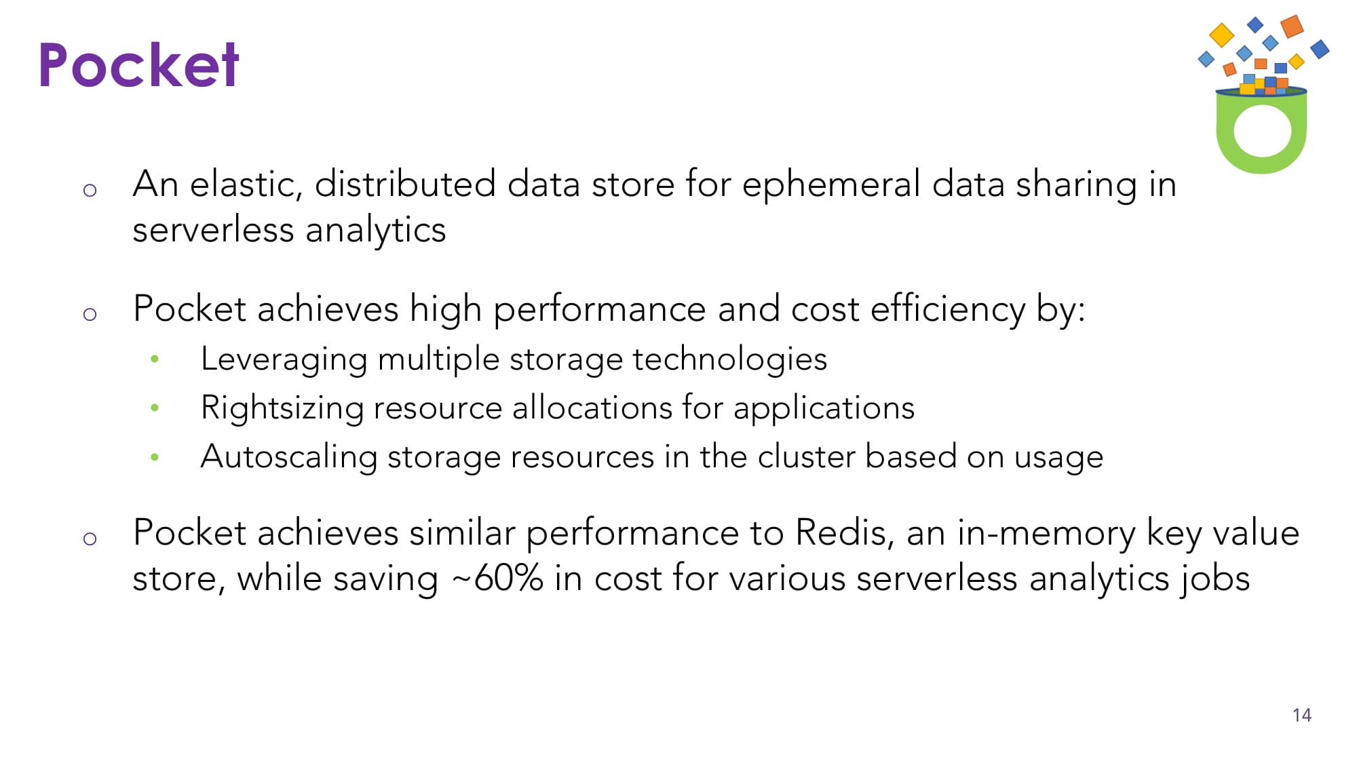

Slide 40
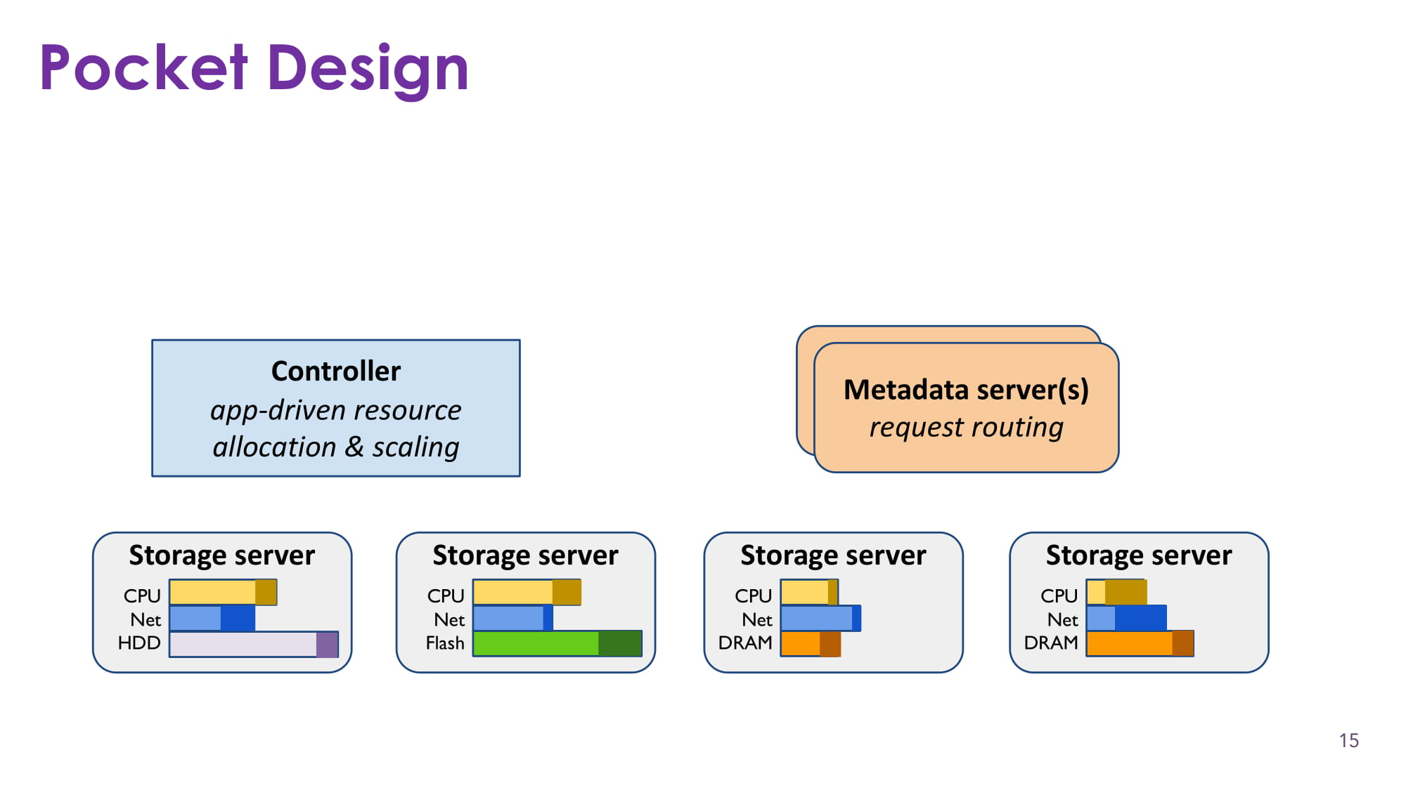

Slide 41
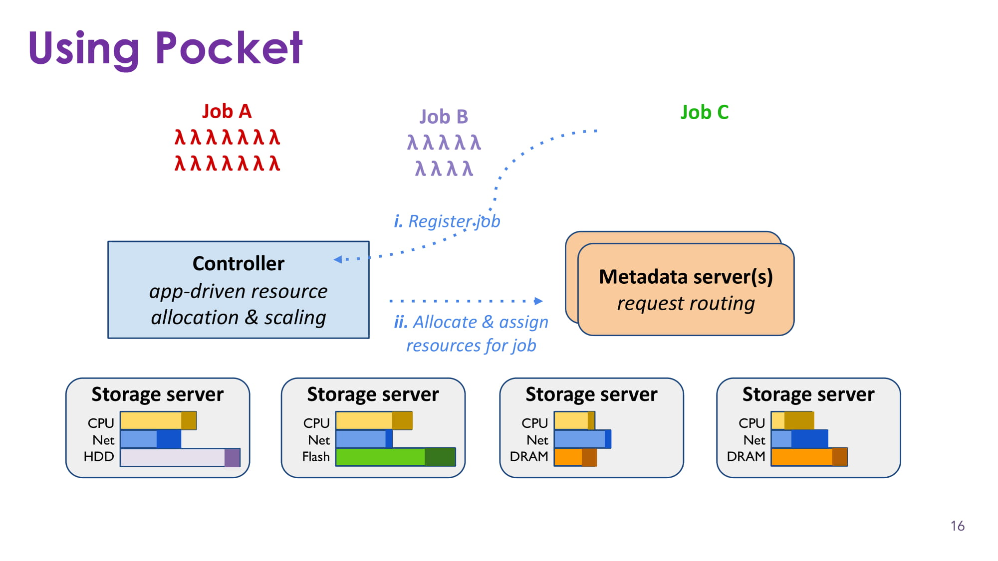

Slide 42
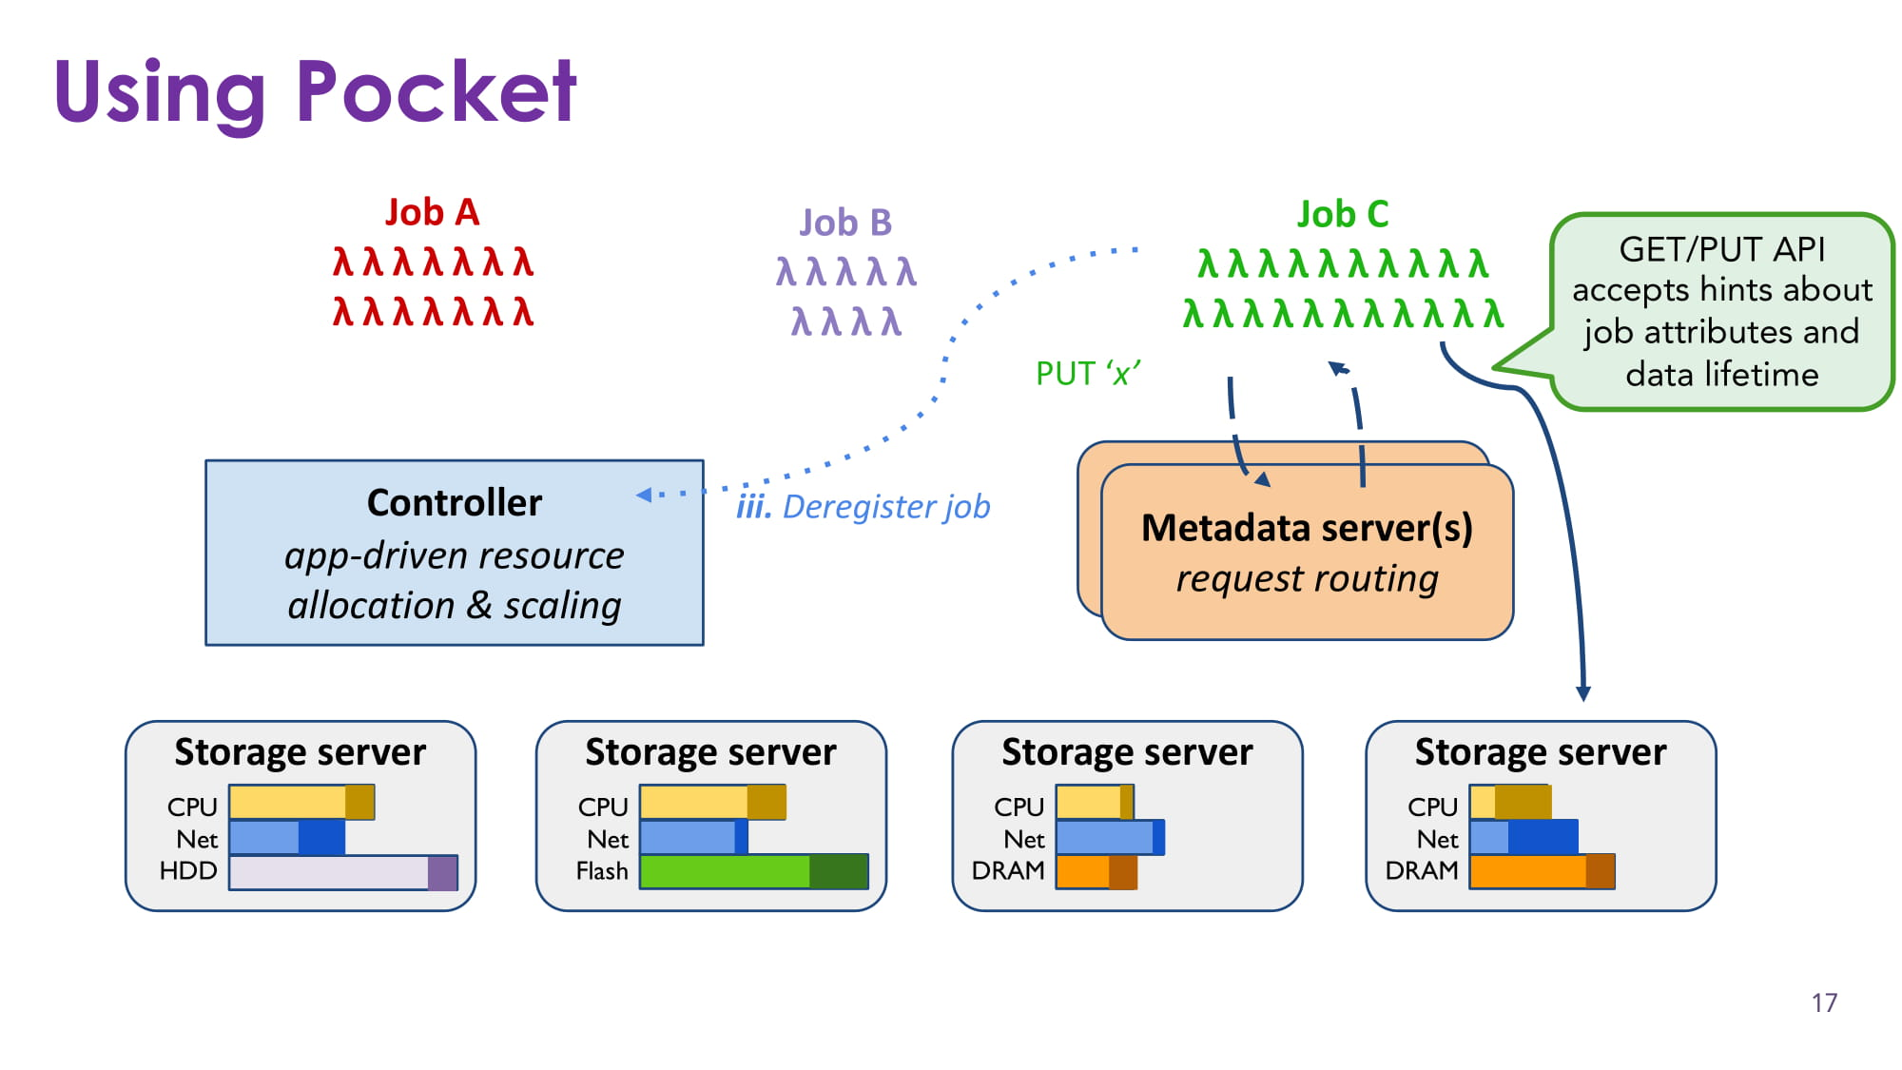

Slide 43
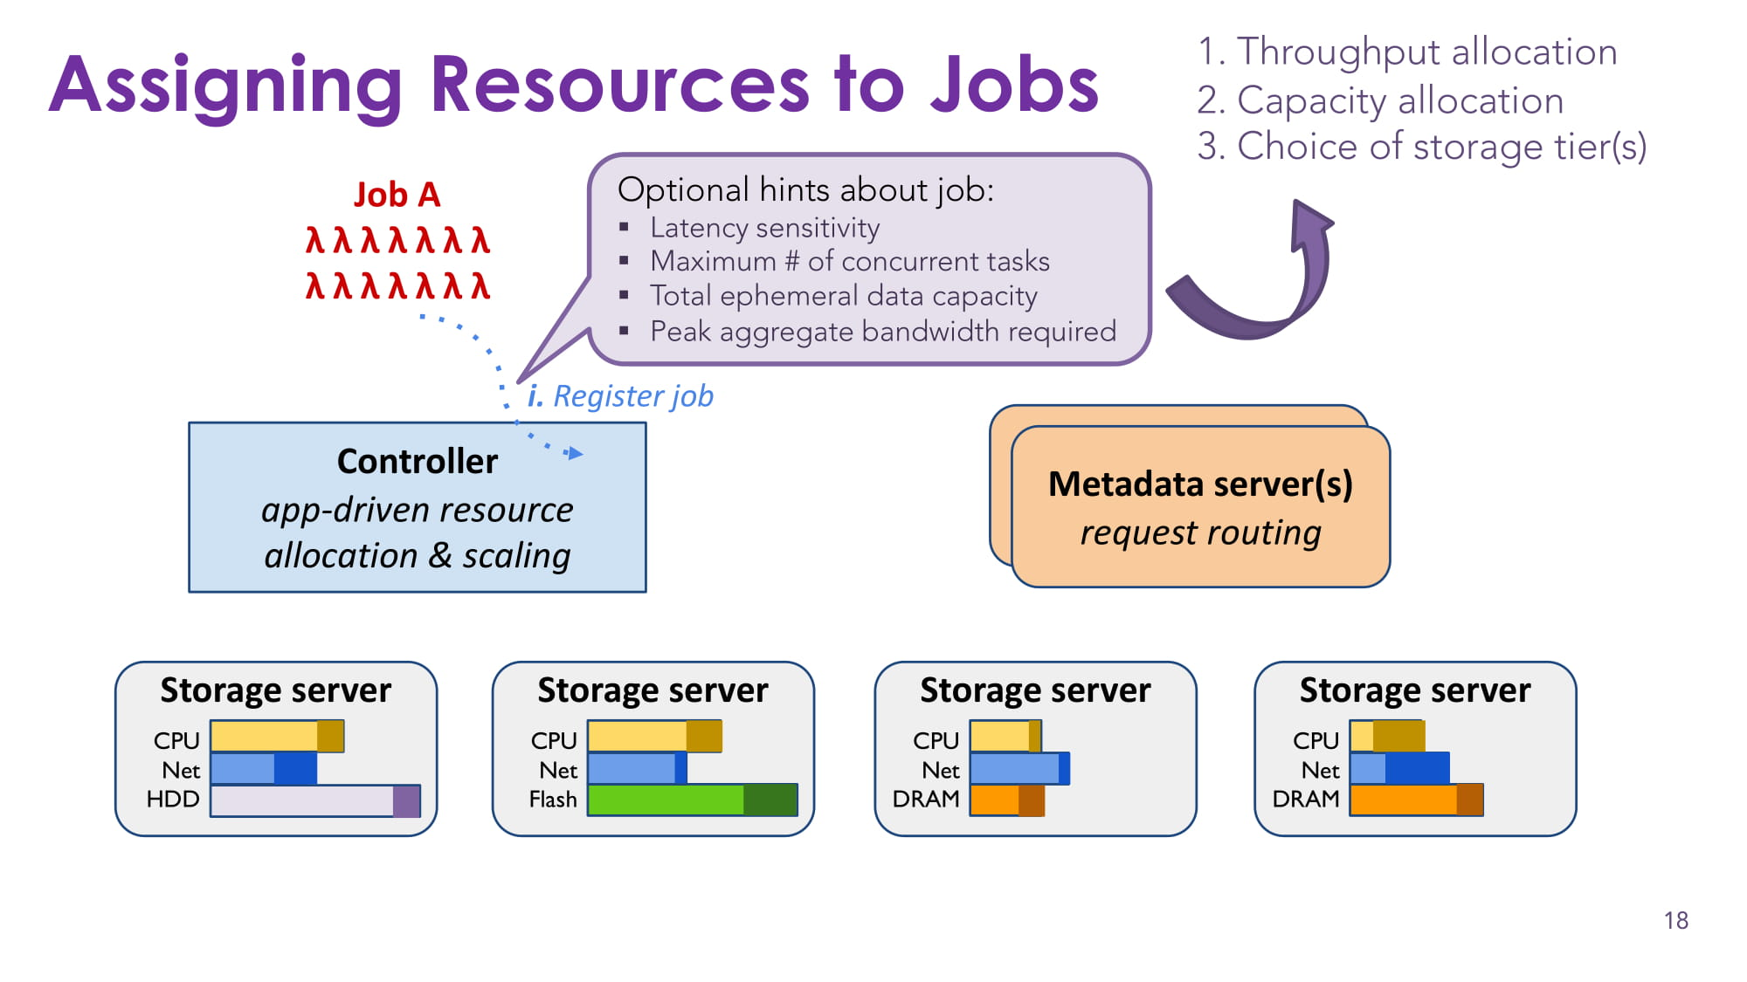

Slide 44
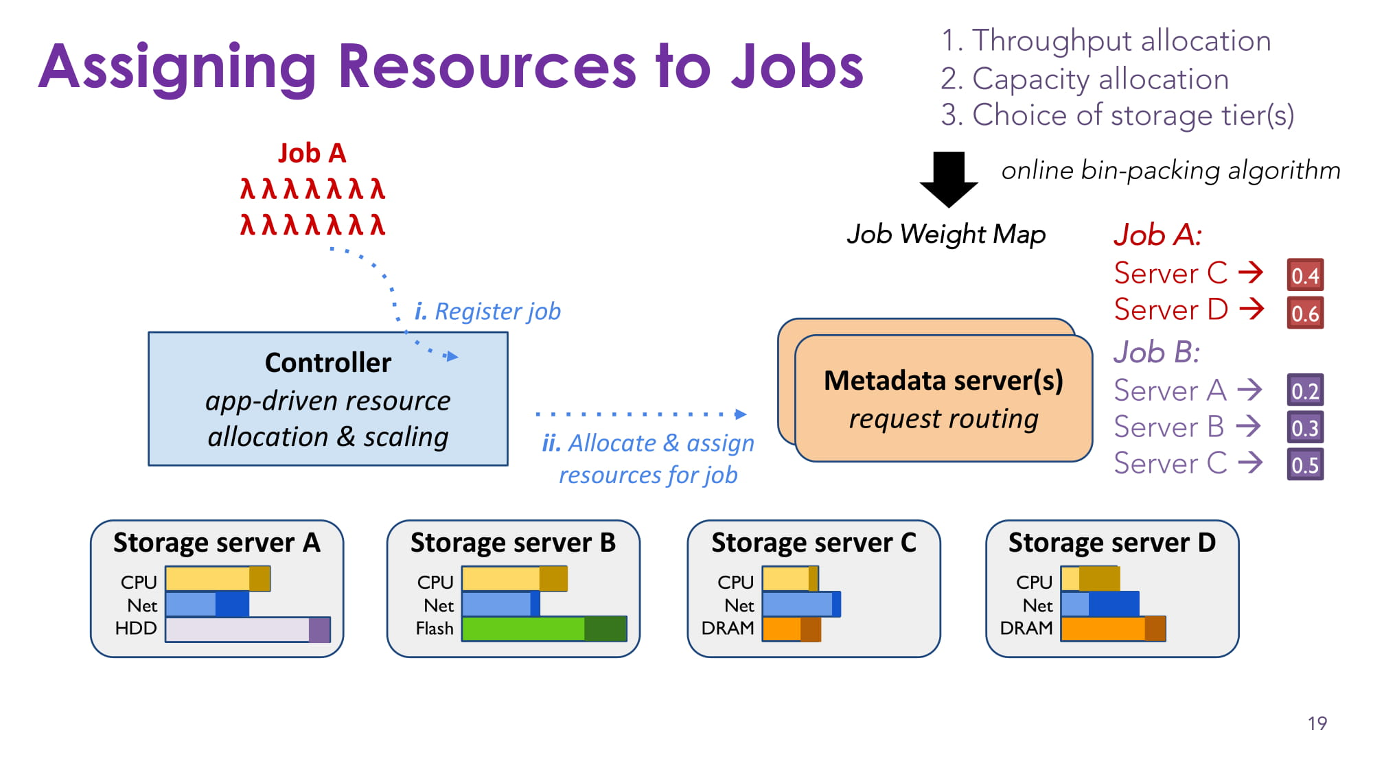

Slide 45
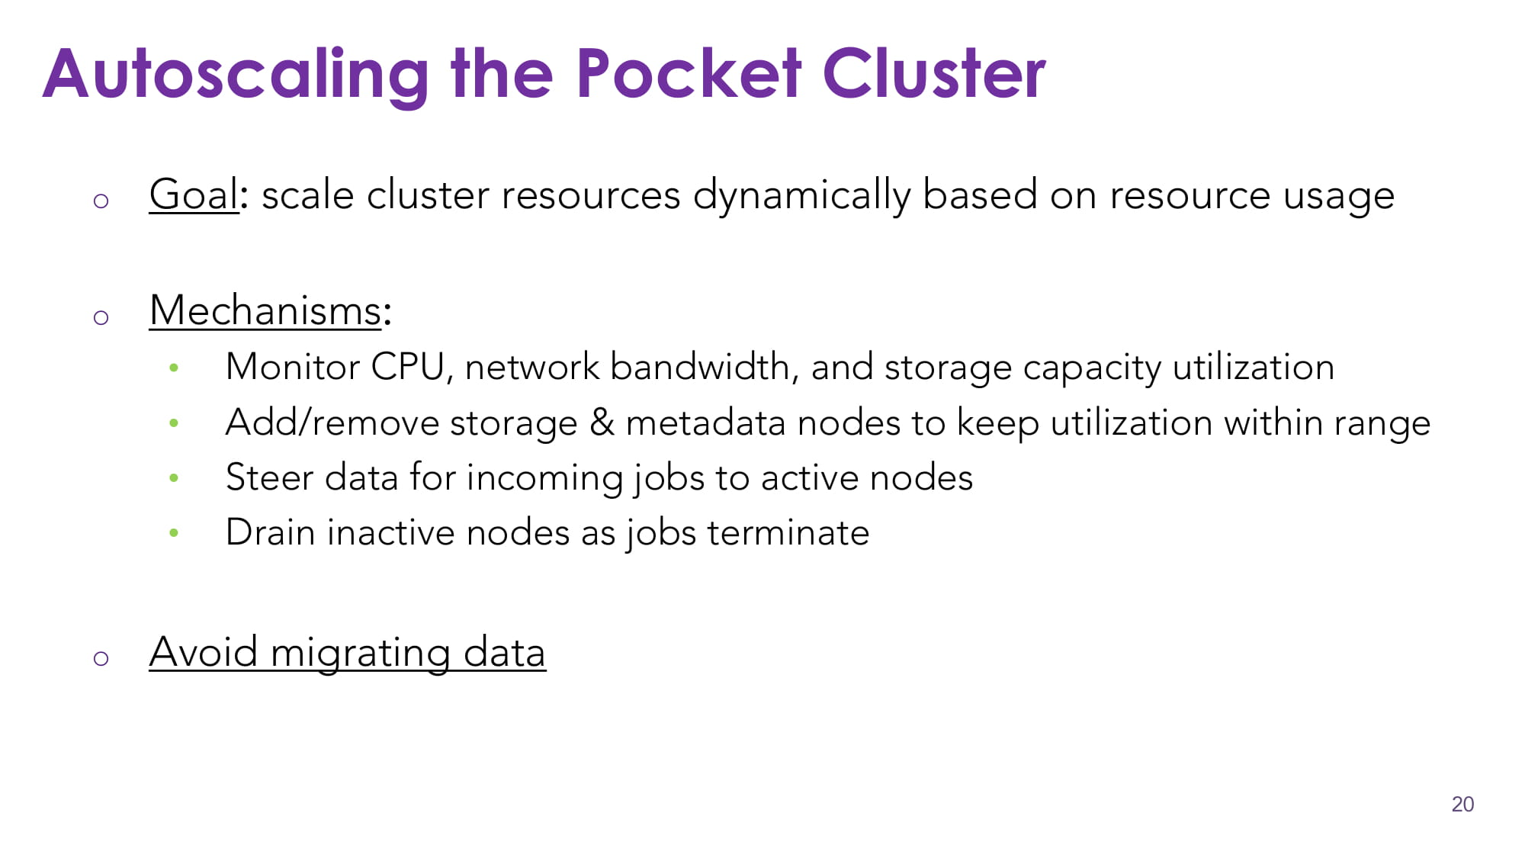

Slide 46
Open Challenges – Computational Units
Reduce the overhead involved in launching lambdas
Currently, lambdas are paused and kept around.
But keeping containers around incurs memory
Leading to memory becoming a bottleneck
Notes:
There are a number of open challenges. In context of computational units, one needs to reduce the overhead involved in launching lambdas.
Pausing leads to a memory bottleneck – need to circumvent the bottleneck – by reducing memory overhead of pausing or using techniques like RDMA.

Slide 47
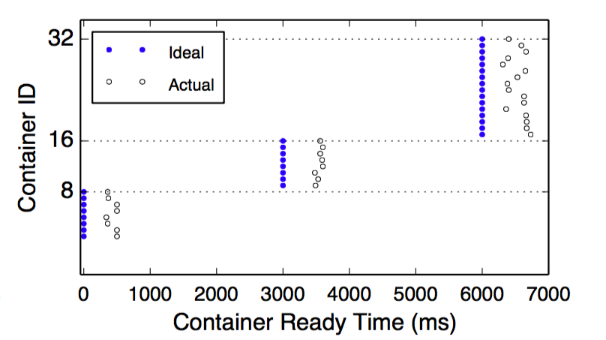
Open Challenges – Computational Units

Slide 48
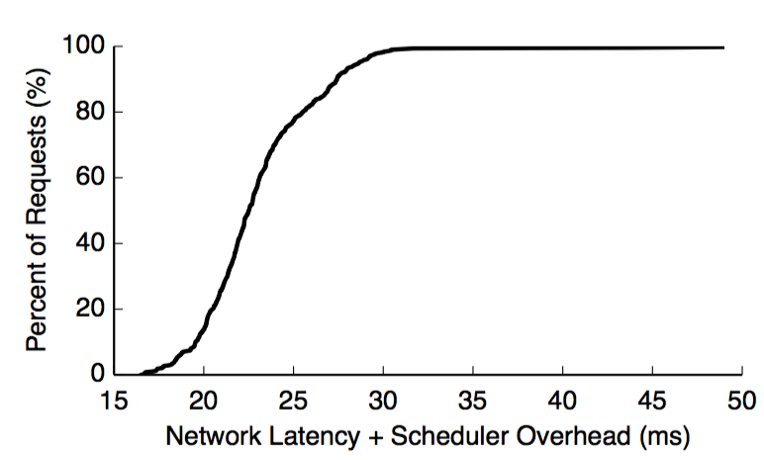
Open Challenges – Scheduling
Existing schedulers were designed for tasks of a few hundred ms
Common case in lambdas is tasks that have an order of magnitude lesser duration
Notes:
Existing schedulers won’t work. Need schedulers that work for tasks that run for a few ms.

Slide 49
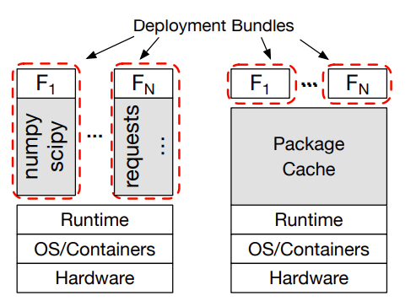
Open Challenges – Package Support
Having no mechanism for efficient package support leads to high startup latencies
Every “new” invocation of the lambda would require downloading of these packages over the network
Notes:
No support for efficient package support – leads to high startup time as library has to be downloaded over the network.

Slide 50
Open Challenges
Support for stateful applications
Appropriate triggers for low latency applications
QoS guarantees
Debugging
Many more ….

Slide 51
Thank You Questions?

